Slide 1
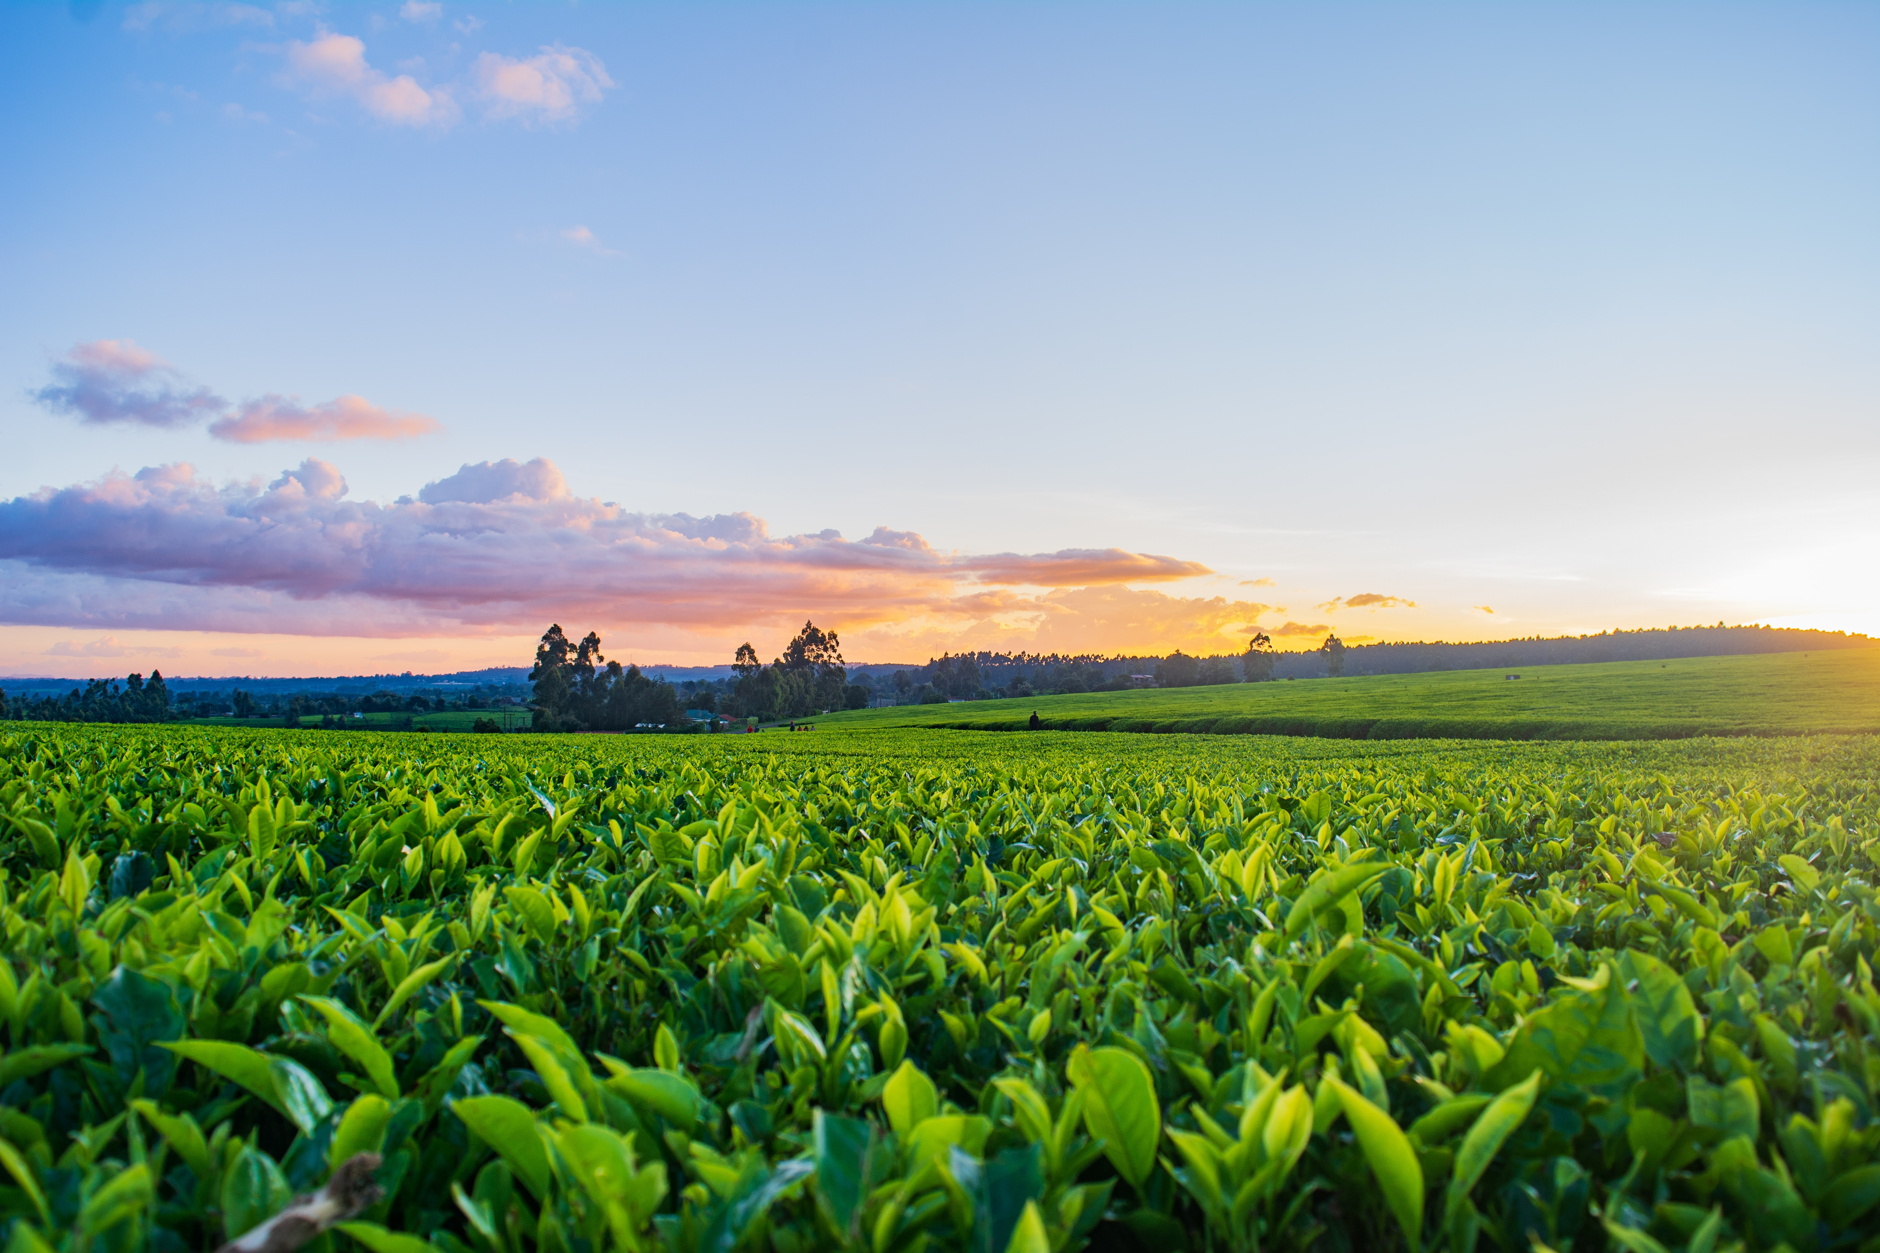
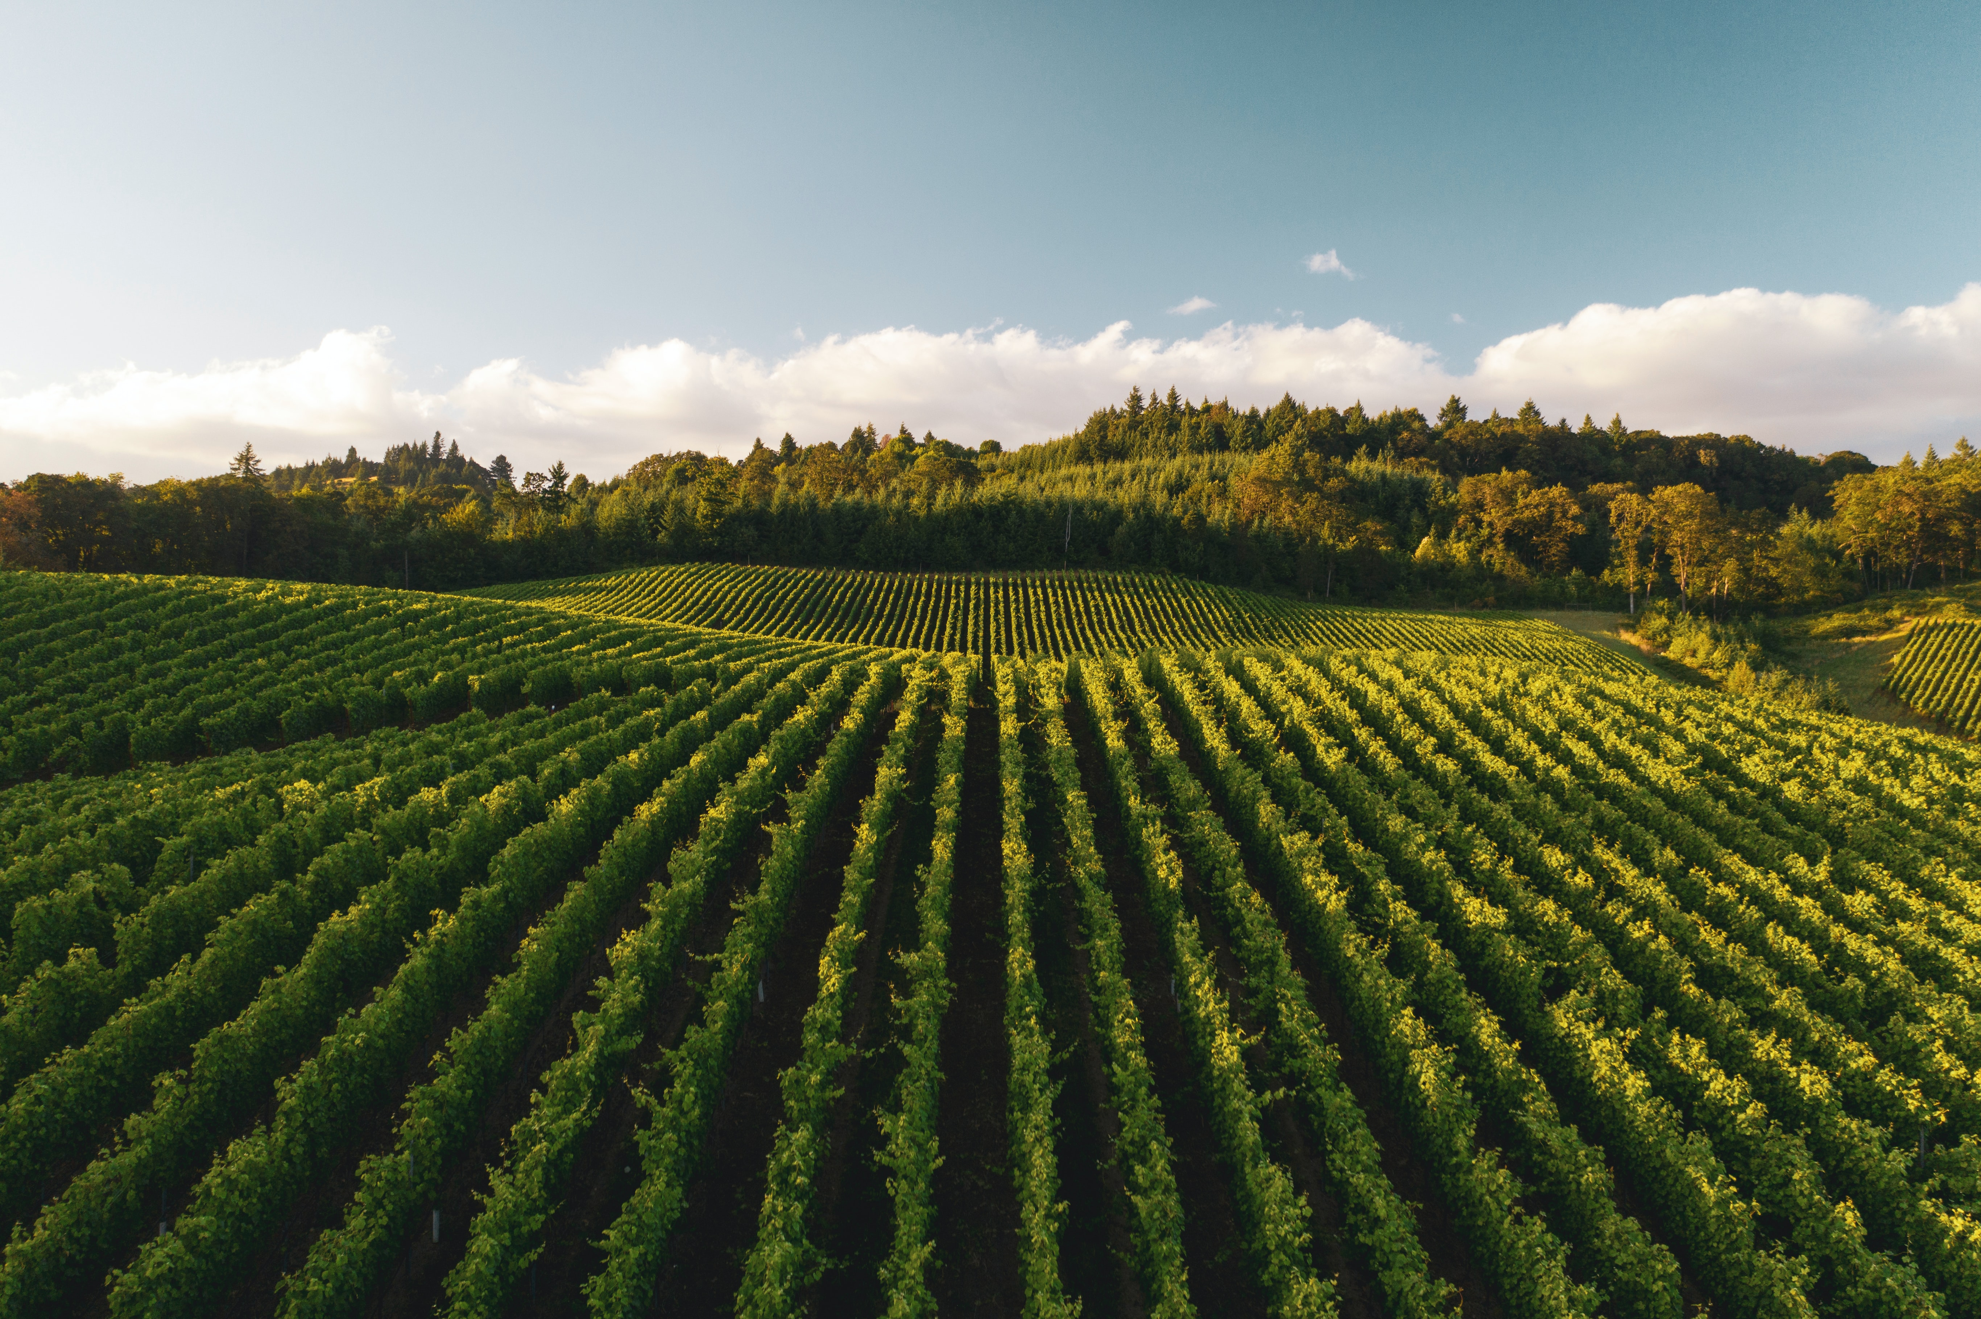
﻿Comparative Study of Machine Learning models for Crop Recommendation System
﻿Riddhi Narkar, ﻿Avishkar Dalvi, ﻿Aarya Totey, ﻿Radha Rakshe, ﻿ Prof. D.S. Khachane
Computer Engineering, A.P. Shah Institute of Technology, Thane, India.
Paper ID 67

Slide 2
Abstract
﻿Farming involves a lot of processes and steps to be done for a good harvest. Many of these processes involve decision-making, for example, the type of fertilizer, irrigation, crop, insecticide, etc. to be used. This work explores one such sector-crop recommendation. We did a comparative study of different machine learning models on a crop dataset to find out which model is the best for this task.

Slide 3
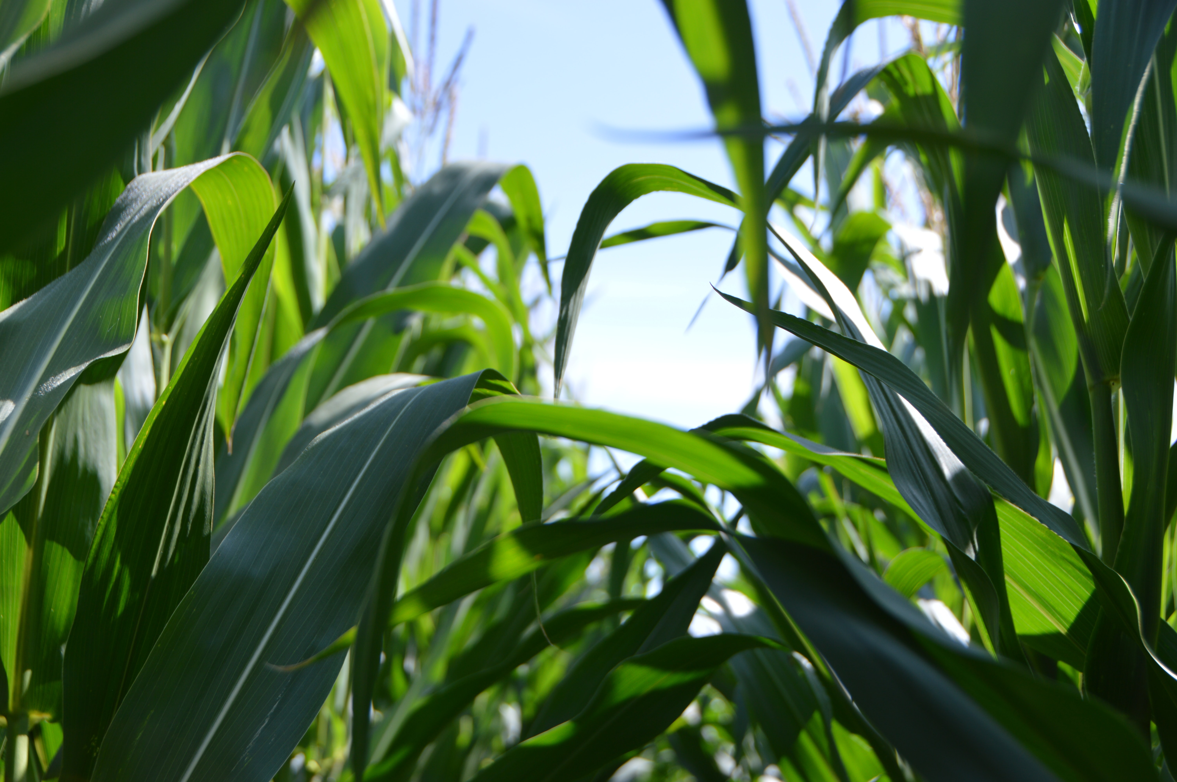
Introduction
﻿Crop cultivation anywhere in the world depends on various factors and a good yield is directly dependent on studying and knowing these factors prior to harvesting. Precision agriculture is the science of improving crop yields and assisting management decisions using high-technology sensor and analysis tools.
A crop recommendation system is a technology that suggests suitable crop options for farmers based on various factors such as soil quality, climate, soil pH, temperature, rainfall, and other relevant parameters and historical records to provide personalized recommendations for a particular farm or region.

Slide 4
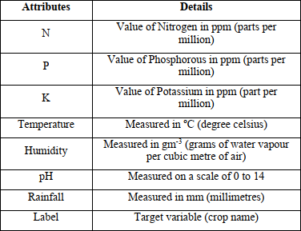
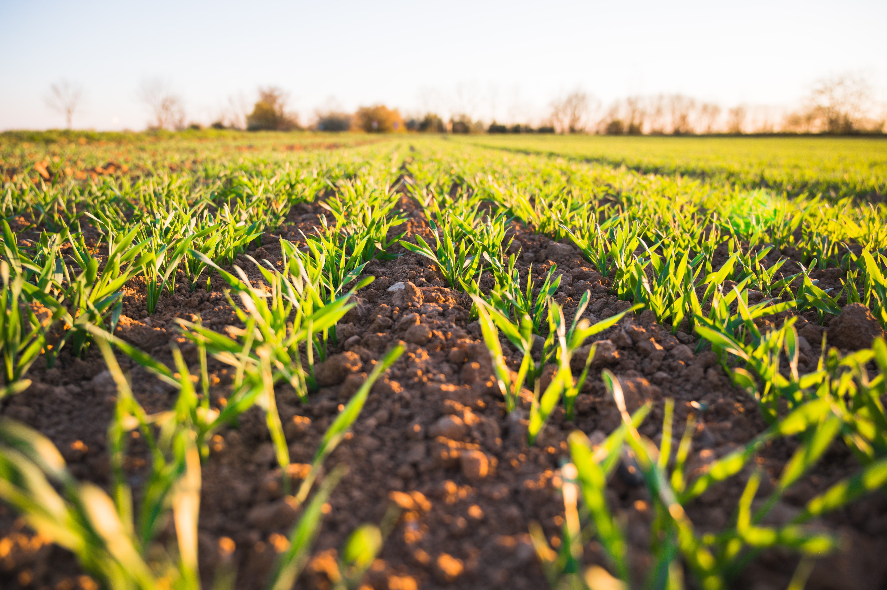
Dataset

Slide 5
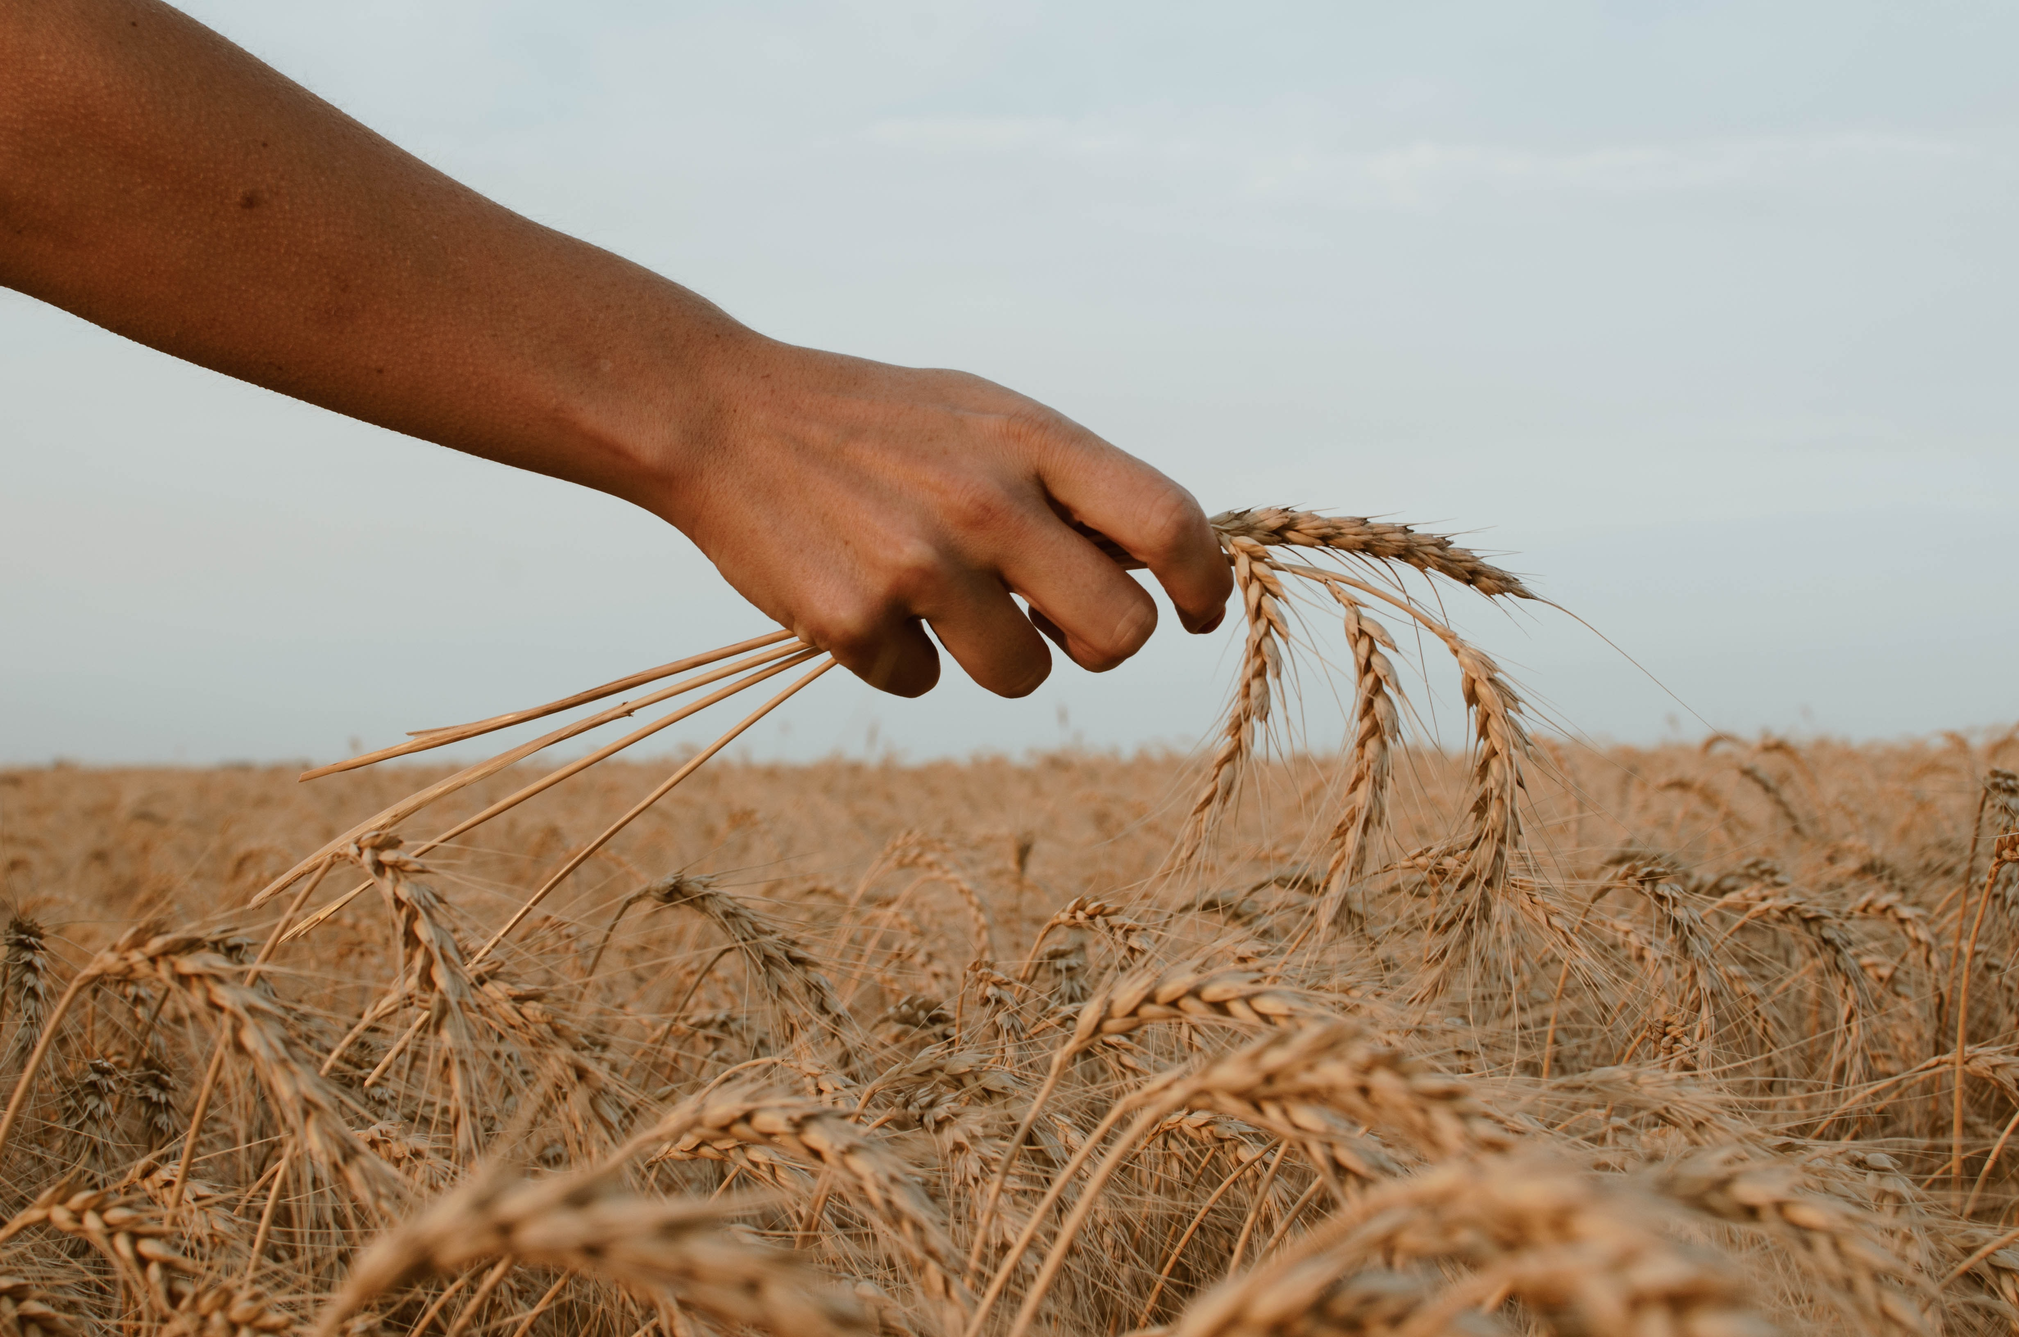
Methodology
Logistic Regression
Naïve Bayes
Decision Tree
SVM
Random Forest
XGBoost

Slide 6
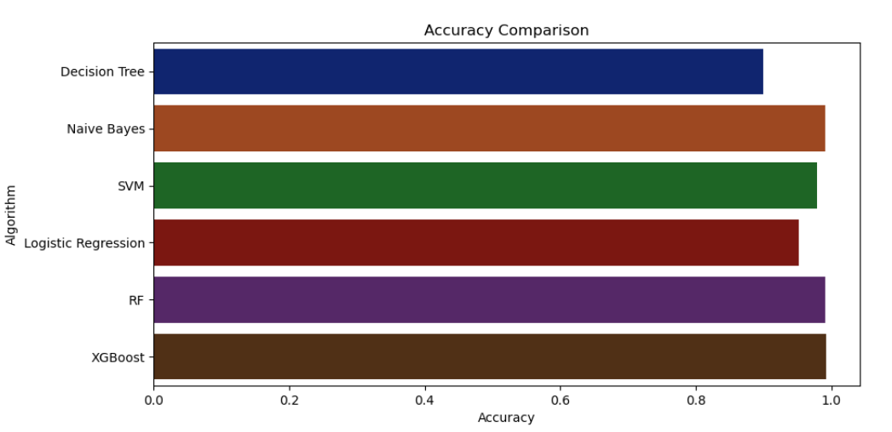
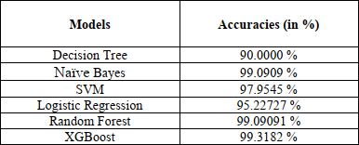
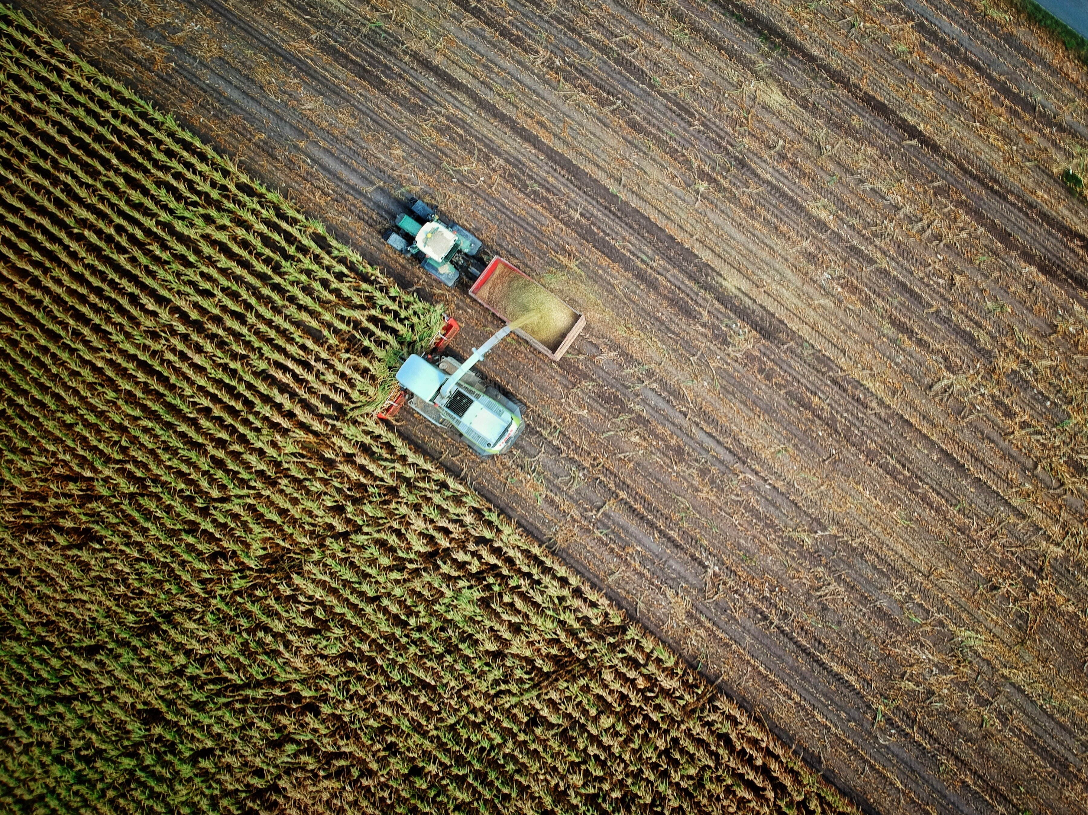
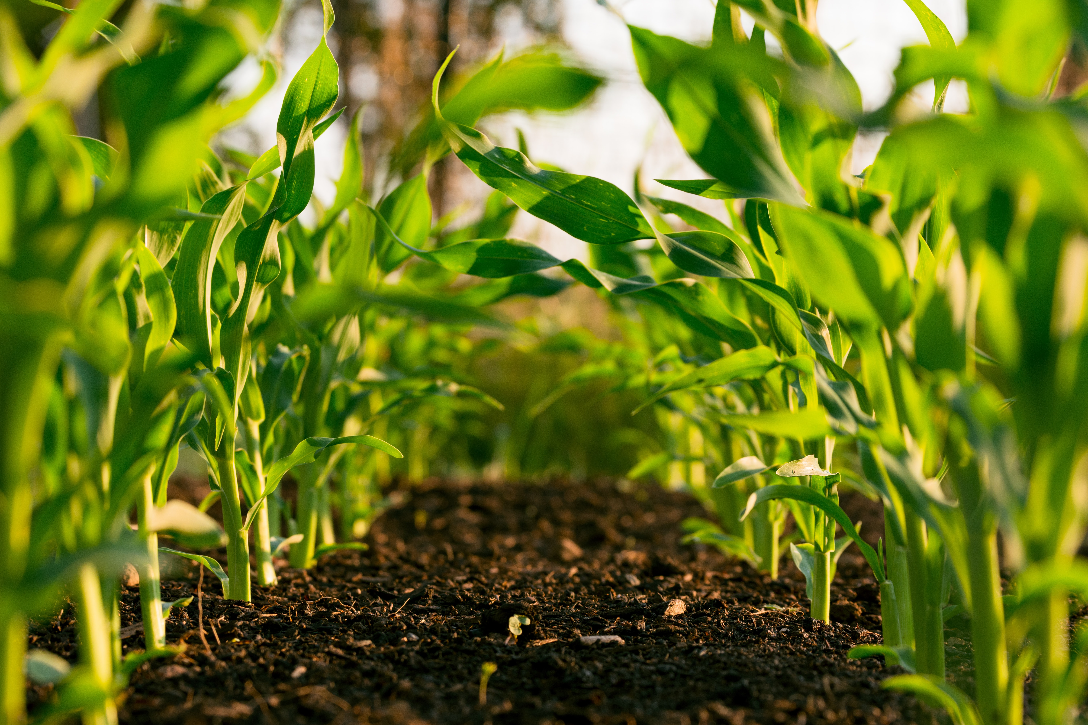
Observations and Results

Slide 7
Thank You!

